Slide 1

Computer Organization & Assembly Language(CS-215T)
Lecture by:
Mr. Shakir Karim
Assistant Professor
DoCS&IT, SSUET
Batch 2022F

Slide 2
Week 2
Computer ALU, Physical and Logical Addresses, Status Flags, Stack and Queue
Computer Science & Information Technology Department
Sir Syed University of Engg. & Tech.
Lecture by: Mr. Shakir Karim

Slide 3
The computer Basic Models
Von Neumann Model
Non Von Neumann Model
Computer Science & Information Technology Department
Sir Syed University of Engg. & Tech.
Lecture by: Mr. Shakir Karim

Slide 4
Von Neumann Model
  Proposed by a Mathematician Von Neumann
  Followed by all stored-program computer
  Possess following characteristics
    Central Processing Unit
    Arithmetic Logic Unit
    Registers
    Main Memory Unit
    I/O Systems
  Bottleneck is the single path for transferring data and instructions
Computer Science & Information Technology Department
Sir Syed University of Engg. & Tech.
Lecture by: Mr. Shakir Karim

Slide 5
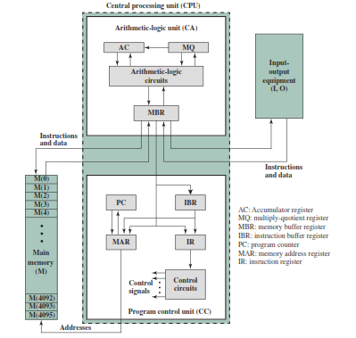
Von Neumann Model
Computer Science & Information Technology Department
Sir Syed University of Engg. & Tech.
Lecture by: Mr. Shakir Karim

Slide 6
Non Von Neumann Model
  AKA Harvard Architecture
  Proposed solution to Von Neumann Bottleneck
  Two buses for data and instructions each
  Data and Instructions are simultaneously transferred
  Mostly used to design special purpose machine
Computer Science & Information Technology Department
Sir Syed University of Engg. & Tech.
Lecture by: Mr. Shakir Karim

Slide 7
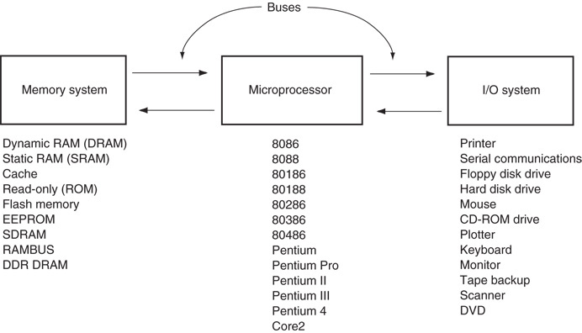
The block diagram of a microprocessor-based computer system
Computer Science & Information Technology Department
Sir Syed University of Engg. & Tech.
Lecture by: Mr. Shakir Karim

Slide 8
Stack and Queue
What is Stack?
LIFO (Last In First Out) Memory
Part of Data Memory (i.e., RAM)
Supports General Purpose Registers to function
What is Queue?
FIFO (First In First Out) Memory
Part of Data Memory (i.e., RAM)
Supports sequencing
Computer Science & Information Technology Department
Sir Syed University of Engg. & Tech.
Lecture by: Mr. Shakir Karim

Slide 9
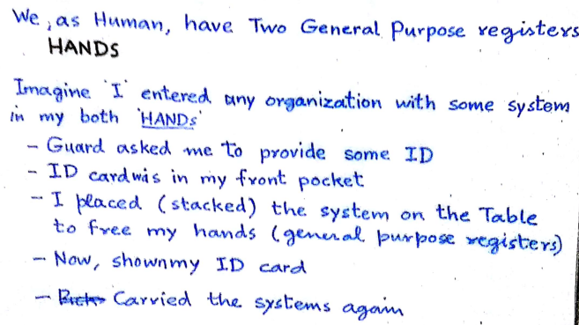
Stack – a Real Life Analogy
Computer Science & Information Technology Department
Sir Syed University of Engg. & Tech.
Lecture by: Mr. Shakir Karim

Slide 10
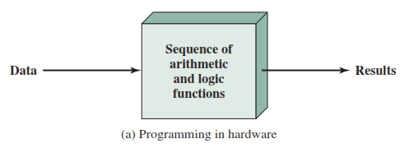
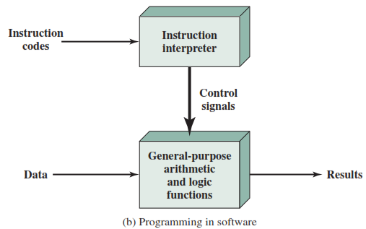
Hardware & Software Approach
Hardwired Program – Specialized hardware
Alternative is Software
Computer Science & Information Technology Department
Sir Syed University of Engg. & Tech.
Lecture by: Mr. Shakir Karim

Slide 11
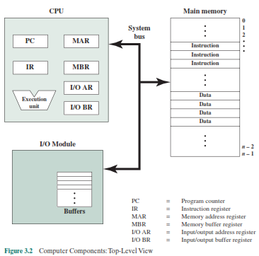
Computer Components
Computer Science & Information Technology Department
Sir Syed University of Engg. & Tech.
Lecture by: Mr. Shakir Karim

Slide 12
Registers
For General Purpose
AX, BX, CX, DX
For Special Purpose
Segment Registers
Index Registers
Flag Register
Computer Science & Information Technology Department
Sir Syed University of Engg. & Tech.
Lecture by: Mr. Shakir Karim

Slide 13
Physical & Logical Addresses
Physical Address
= (scaled) Segment Address
+
Offset Address
A Segment is equal to 64 KB of memory
Computer Science & Information Technology Department
Sir Syed University of Engg. & Tech.
Lecture by: Mr. Shakir Karim

Slide 14
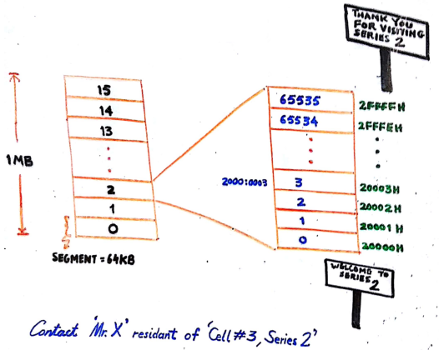
Physical & Logical Addresses
Computer Science & Information Technology Department
Sir Syed University of Engg. & Tech.
Lecture by: Mr. Shakir Karim

Slide 15
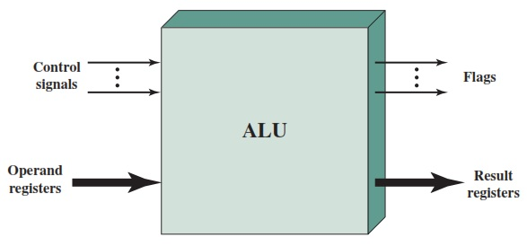
Arithmetic Logic Unit
The block diagram
Computer Science & Information Technology Department
Sir Syed University of Engg. & Tech.
Lecture by: Mr. Shakir Karim

Slide 16
Arithmetic Logic Operations
NOT / CPL
AND / NAND
OR / NOR
XOR / XNOR
CMP
SHL / SHR
ROL / ROR
RCL / RCR
ADD / ADC
SUB / SBB
MUL / IMUL
DIV / IDIV
Computer Science & Information Technology Department
Sir Syed University of Engg. & Tech.
Lecture by: Mr. Shakir Karim

Slide 17
Integer Arithmetic
How many types of integer?
Signed and Unsigned.
How to represent an integer?
Signed Integer
Sign-Magnitudes
1’s complement
2’s complement
Computer Science & Information Technology Department
Sir Syed University of Engg. & Tech.
Lecture by: Mr. Shakir Karim

Slide 18
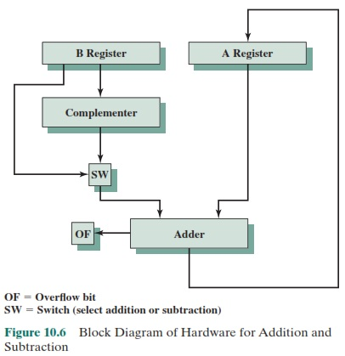
Addition and Subtraction
Remember Adder-Subtractor circuit from session 1
Computer Science & Information Technology Department
Sir Syed University of Engg. & Tech.
Lecture by: Mr. Shakir Karim

Slide 19
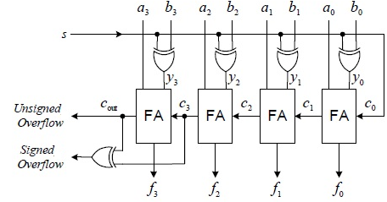

Adder-Subtractor Circuit
Computer Science & Information Technology Department
Sir Syed University of Engg. & Tech.
Lecture by: Mr. Shakir Karim

Slide 20
Adder-Subtractor Circuit
Computer Science Department
Sir Syed University of Engg. & Tech.
Lecture by: Mr. Shakir Karim

Slide 21
Adder-Subtractor Circuit
Computer Science Department
Sir Syed University of Engg. & Tech.
Lecture by: Mr. Shakir Karim

Slide 22
Subtraction Rules
Using 2’s complement
Take 2’s complement of the –ve number
Add the two numbers
Invert the carry out
  If inverted carry = 0, then the answer is +ve
  If inverted carry = 1, then the answer is –ve
  and it is in 2’s complement
Computer Science & Information Technology Department
Sir Syed University of Engg. & Tech.
Lecture by: Mr. Shakir Karim

Slide 23
Subtraction Rules
Example (i)
32 -14 = 32 + (-14)
00100000 (32)
11110010 (-14)
00010010 (+18)
CY = 1
Inverted CY = 0
Answer is +ve
00010010
Example (ii)
-32 +14
11100000 (-32)
00001110 (+14)
11101110 (-18)
CY = 0
Inverted CY = 1
Answer is –ve
11101110 (2’s complement)
Computer Science & Information Technology Department
Sir Syed University of Engg. & Tech.
Lecture by: Mr. Shakir Karim

Slide 24
Flag Register
An indicator to inform about the status/control
Status Flags
Carry
Auxiliary Carry
Overflow
Parity
Sign
Zero
Control Flags
Trap
Interrupt
Direction
Computer Science & Information Technology Department
Sir Syed University of Engg. & Tech.
Lecture by: Mr. Shakir Karim

Slide 25
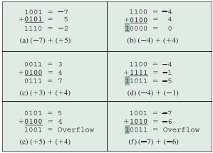
Overflow?
Computer Science & Information Technology Department
Sir Syed University of Engg. & Tech.
Lecture by: Mr. Shakir Karim

Slide 26

Overflow?
Computer Science & Information Technology Department
Sir Syed University of Engg. & Tech.
Lecture by: Mr. Shakir Karim

Slide 27
Overflow?
Computer Science & Information Technology Department
Sir Syed University of Engg. & Tech.
Lecture by: Mr. Shakir Karim

Slide 28
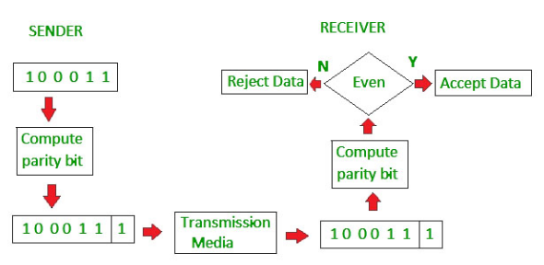
Parity Flag
Even Parity System
If even number of 1’s then 0 is added
Else 1 is added
Computer Science & Information Technology Department
Sir Syed University of Engg. & Tech.
Lecture by: Mr. Shakir Karim

Slide 29
Zero Flag
Used to check whether the answer is zero or not
Set, if answer is zero
Clear, if answer is not zero
Computer Science & Information Technology Department
Sir Syed University of Engg. & Tech.
Lecture by: Mr. Shakir Karim

Slide 30
Auxiliary Flag
Used in BCD arithmetic only
Set, if a carry is generated from bit#3 (fourth bit)
to bit#4 (fifth bit)
Computer Science & Information Technology Department
Sir Syed University of Engg. & Tech.
Lecture by: Mr. Shakir Karim

Slide 31
Carefully read pages
23 to 31 and 33 to 40 from Chapter 1 of
The 80x86 IBM PC and Compatible Computers (Vol. I & II) Assembly Language, Design, and Interfacing (4th Ed.) by Muhammad Ali Mazidi and Janice Gillispie Mazidi Pearson Education, Inc. Upper Saddle River, New Jersey 07458
Computer Science & Information Technology Department
Sir Syed University of Engg. & Tech.
Lecture by: Mr. Shakir Karim

